Slide 1


Maths Workshop KS1
2024 – 2025
Portfields’ Bridge
Believe I can - Respect & kindness - Involve everyone - Dream big - Grown minds - Empower learners

Slide 2
Aims for today
To understand a Mastery Approach to maths?
To explain Concrete, Pictorial and Abstract (CPA) approaches in math
Show how math strategies develop across Key Stage 1
Share useful resources and websites to support learning at home
Notes:
Everyone is good at math

Slide 3
What do we teach in KS1 Maths?
• Number bonds from 10 and 20 ( ie 7+3=10, 18+2= 20 (see relationship 17 + 3 = 20)
• Basic multiplication (2,3,5, 10)
• Basic division ( 2)
• Fractions ( ½ , ¼, 1/3 )
• Addition and subtraction to 100
• Place value (units, tens and hundreds)
• Time (o’clock, half past, quarter to, quarter past)
• Measurement (weight, length, capacity)
• Money (everyday money- calculating change)
• Problem solving
• Handling data (graphs, tables, sorting data)
• Shape and space
Notes:
The government no longer requires us to complete KS1 SATs, although they do still produce the assessments, and we still use them. This is done inline with the rest of the school’s assessment weeks and is only used for internal purposes.

Slide 4
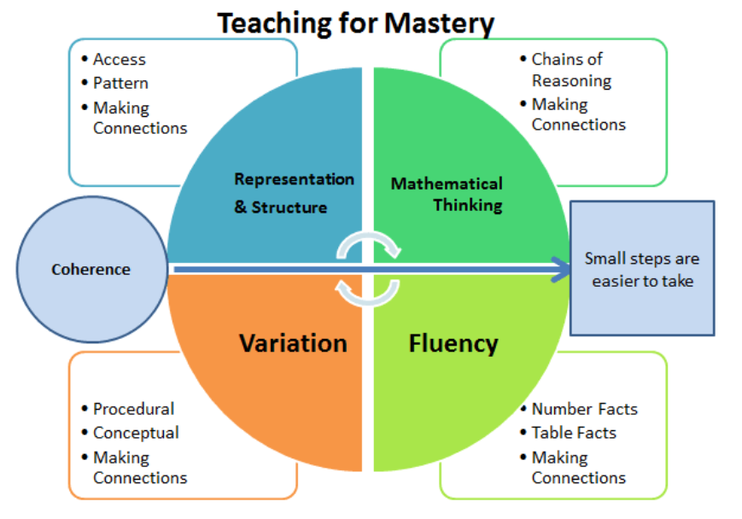
The Mastery Approach

Slide 5
The Mastery Approach
Mastering maths means children acquire a deep, long-term, secure and adaptable understanding of maths
The phrase ‘teaching for mastery’ describes the elements of classroom practice and school organisation that combine to give pupils at Portfields the best chances of mastering maths.
Achieving mastery means acquiring a solid understanding of the maths that is been taught to enable pupils to move on to more advanced material.
Acquiring mastery of maths is for all children!

Slide 6
What does the Mastery Approach look like at Portfields?
Whole class move through the maths content at the same pace.
Each topic is studied in depth to ensure all children can demonstrate a secure understanding of mathematical concepts
No ability grouping or sets. Instead students are given time to think deeply.
Not limiting children but building children who are confident and resilient.
Notes:
We do not group or set children at Portfields. This limits the children’s access to the full curriculum and from a young age children start to believe that they are either those who can do maths and those who can’t. Everyone can do maths. Differentiations still happens those who are grasp concepts easily are challenged with rich and sophisticated problems to deepen their understanding and those who require more assistance are given just that to consolidate their understanding before moving on.

Slide 7
C.P.A method: Concrete, Pictorial Abstract
The Concrete, Pictorial, Abstract approach (CPA) is a highly effective approach to teaching that develops a deep and sustainable understanding of maths in pupils
Concrete- the use of manipulatives / physical resources to demonstrate the process behind what is being taught.
Pictorial- visual aids that help children understand and solve problems. They can include drawings, bar models, part-whole diagrams, or base ten drawings.
Abstract - is the “symbolic” stage, where children use abstract symbols to model problems. Students will not progress to this stage until they have demonstrated that they have a solid understanding of the concrete and pictorial stages of the problem.
Notes:
The Concrete stage encourages the use of manipulatives and physical resources to physically show the process behind what is being taught. At its most basic level, this can be as simple as using counters, sweets, marbles, etc to show numbers/amounts, allowing children to visualise the idea of more or less or comprehend what 3 (or any given number) actually is.
• All of the main mathematical operations can be introduced and explored in this way. You’ll find that learners love getting involved with this hands-on approach
Once secure with understanding at the concrete stage, pupils move on to pictorial based problem-solving and expression. The physical resources are generally replaced with a pictorial representation. Additionally, visual support strategies such as ten frames, bar models and part whole representations are used for pupils to show their understanding through answering questions using these visuals.
• The pictorial stage is essential for learners to consolidate and secure their understanding of topics. It bridges the gap between getting to grips with a concept (quite literally) and knowing how to combat more abstract ideas.

Slide 8
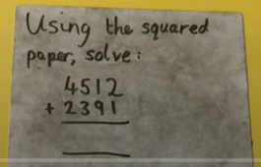
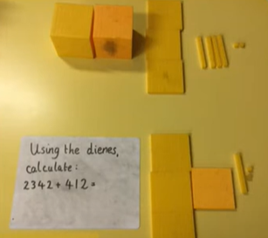
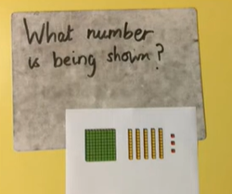
Which is which?

Slide 9
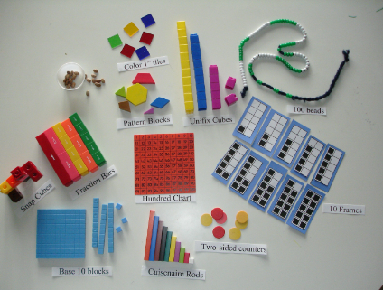
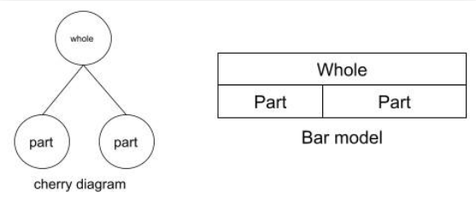
Notes:
Variety- showing them in different way

Slide 10
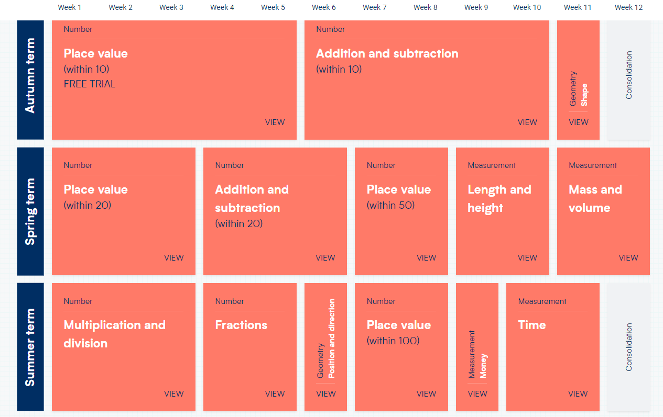
White Rose Maths
Notes:
The maths LTP is available on our website

Slide 11
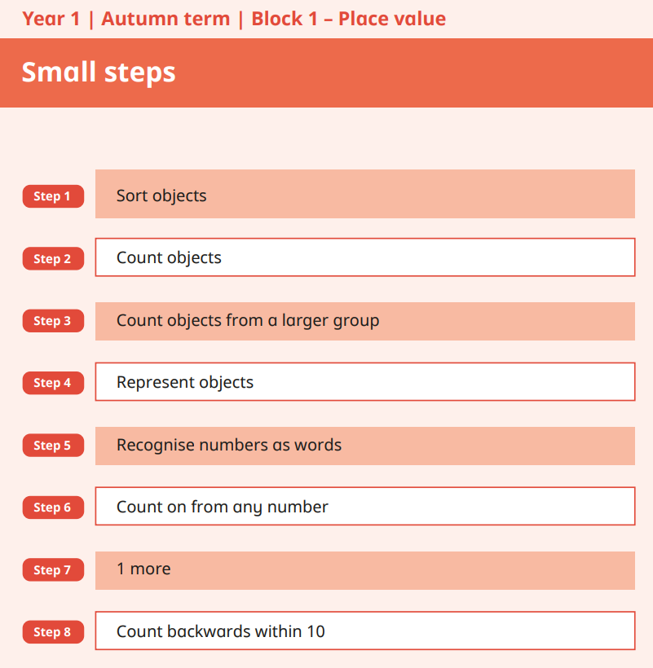
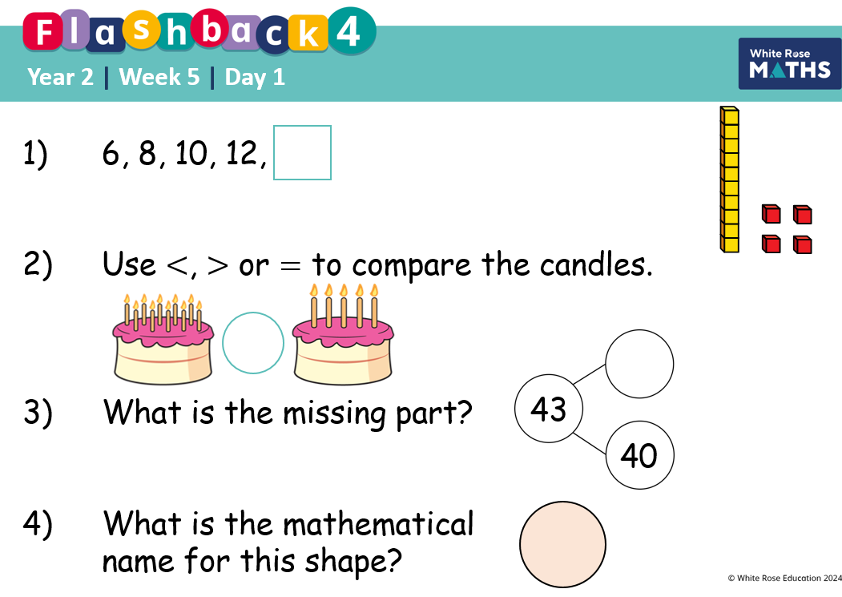
White Rose Maths
Notes:
We move in small steps to ensure that deep understanding.
Each lesson starts with a flashback 4 which allows for previous learning to be revisited. We use flash backs across the school to ensure we are closing gaps if any. Some content is only covered in 1 particular year group and therefore needs to be revisited so children remember. Flashback completed in books.
Year 1 autumn term start on WB until comfortable to complete in book.

Slide 12
LO: To subtract across 10
Notes:
Children would have their own 10 frame and counters. The teacher would be

Slide 13

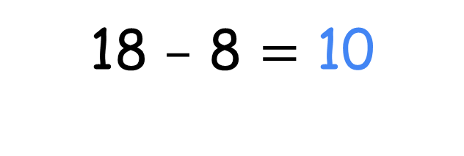
What do you notice?
Notes:
An example of a Y2 lesson. Teacher to model this with children using frame 10 nd counters

Slide 14
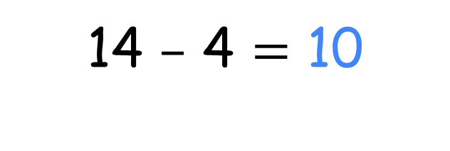

Have a think

Slide 15

First, I will subtract 3 and then 4
Why does Tiny do this?
Have a think
Notes:
Rekenreks concrete resource that children will be come familiar with as they use this in their mastery number sessions.
Similar to an abacus, help children to s a maths counting frame build good number sense through the maths mastery approach that that uses hands-on activities to help children make meaningful connections to early years maths concept
Tiny demonstrating his reasoning as Reasoning is part of each lesson. This allows the children to discuss this thus promoting theirs.

Slide 16
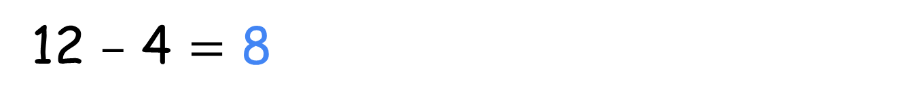
How is this similar to using a Rekenrek?
How is it different?
Have a think

Slide 17



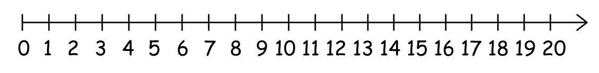
4
2
2
4
1
5
0
I can partition 6 into ___ and ___
6
Notes:
A number line shown to demonstrate as well as sentence stems to help

Slide 18




6
1
I can partition 7 into 6 and 1
Amir
Have a think
Do you agree with Amir?

Slide 19
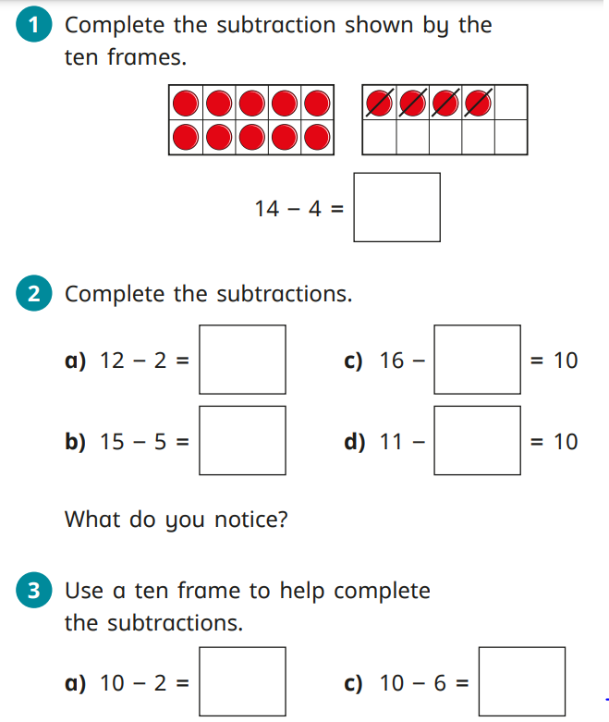
Notes:
Book work. Were the work is shown abstract. However the children will still have the concrete on their tables to support them

Slide 20
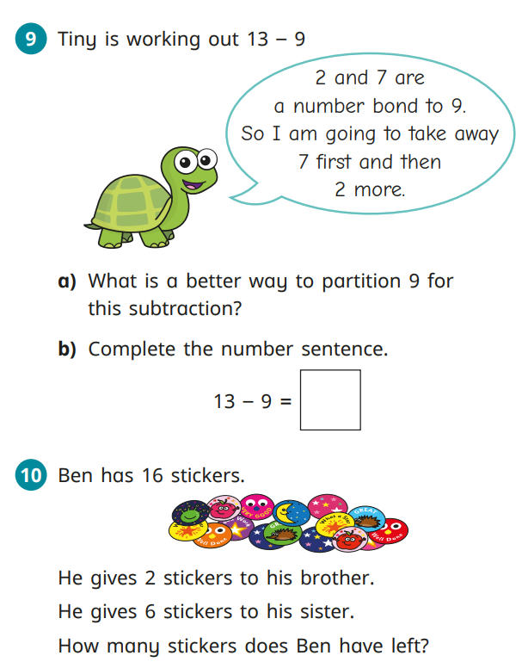

Slide 21
Mastering Number KS1
This aims to secure a firm foundations in the development of good number sense for all children from Reception through to Year 2.
Children will leave KS1 with fluency in calculation and a confidence and flexibility with number.
Attention will be given to key knowledge and understanding needed in Reception classes, progression through KS1 to support success in the future.
There is a lot of focus on subitising this term. This is the development of quick recognition of number skills from 1 -10 without counting.
As well as looking at all the parts that make up a number, composition.

Slide 22
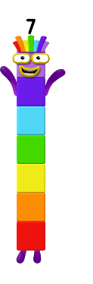
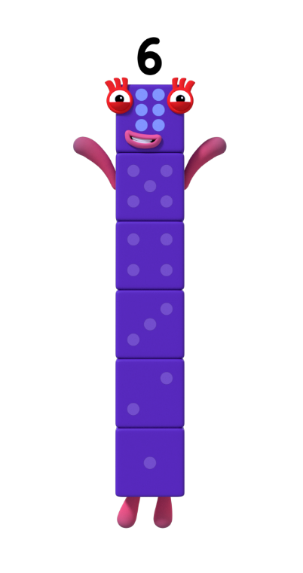
What helps you remember what 5 needs to make 6 or 7?
Play the ‘6 or 7?’ game!
Images © 2021 Alphablocks Ltd. All rights reserved. Mastering Number 2021/22 ncetm.org.uk
Notes:
Sentence stems to help remember where children are encouraged to repeat to help remember the composition of the number.
They would have looked at this previously.
6 is made of 5 and 1 ………. 5 and 1 make 6

Slide 23

6 or 7?
_____ is made of 5 and _____ ;
5 and _____ make _____ .
Images © 2021 Alphablocks Ltd. All rights reserved. Mastering Number 2021/22 ncetm.org.uk

Slide 24
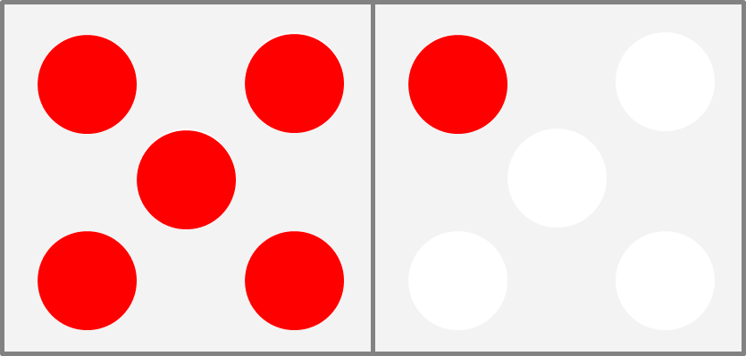
6 or 7?
_____ is made of 5 and _____ ;
5 and _____ make _____ .
Images © 2021 Alphablocks Ltd. All rights reserved. Mastering Number 2021/22 ncetm.org.uk
Notes:
Hungarian number pattern

Slide 25
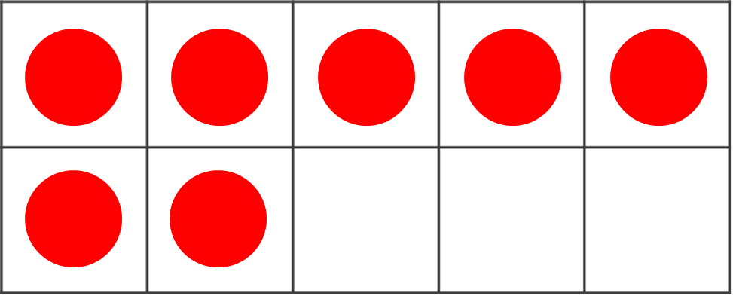
6 or 7?
_____ is made of 5 and _____ ;
5 and _____ make _____ .
Images © 2021 Alphablocks Ltd. All rights reserved. Mastering Number 2021/22 ncetm.org.uk
Notes:
Ten frame- fluency

Slide 26
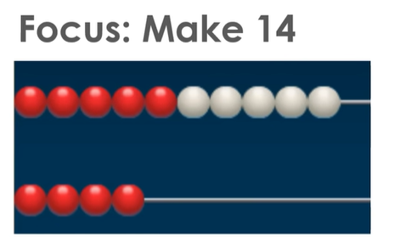
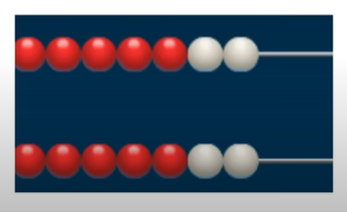
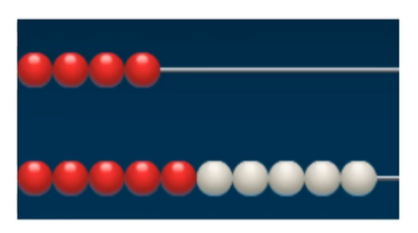
Notes:
Rekenrek
A) is the right one
B) children might say it 4 teen and therefore write 4 1
C) looks at doubles which they will eventually do
In this particular lesson Children will all make it the same way in order to understand that there is one 10 and 4 ones to make 14 using a rekenrek

Slide 27
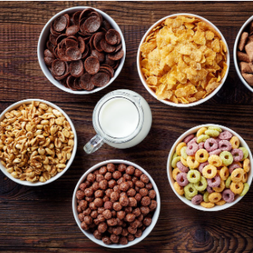



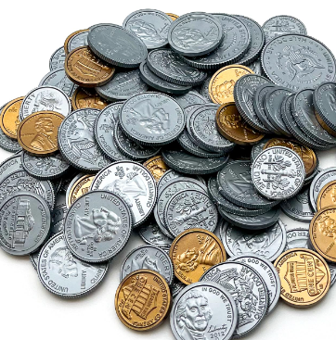
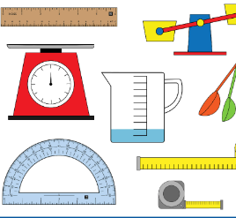
Supporting at home!
Making maths practical by using real materials.
Try some of these at home with your child
At the shops
Using food
Talking time
Using money
Measuring
During cooking
Notes:
Compare I have more/less socks, spoons, estimate guessing game,

Slide 28
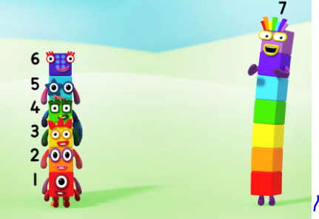
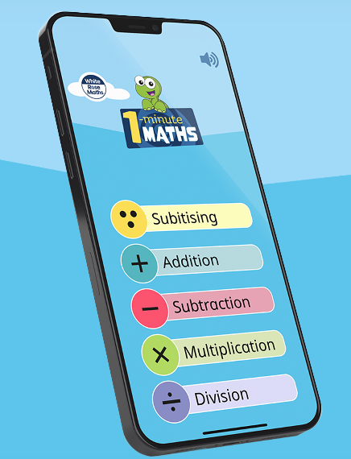
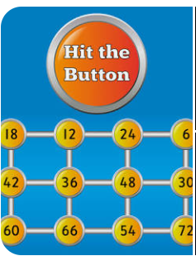
Supporting at home!
Notes:
Number block BBC iPlyaer
Hit the button
Top marks
WhiteRose
Role play

Slide 29
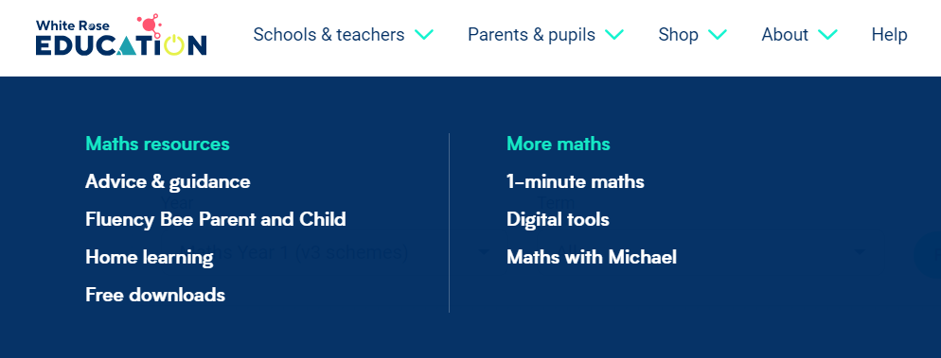
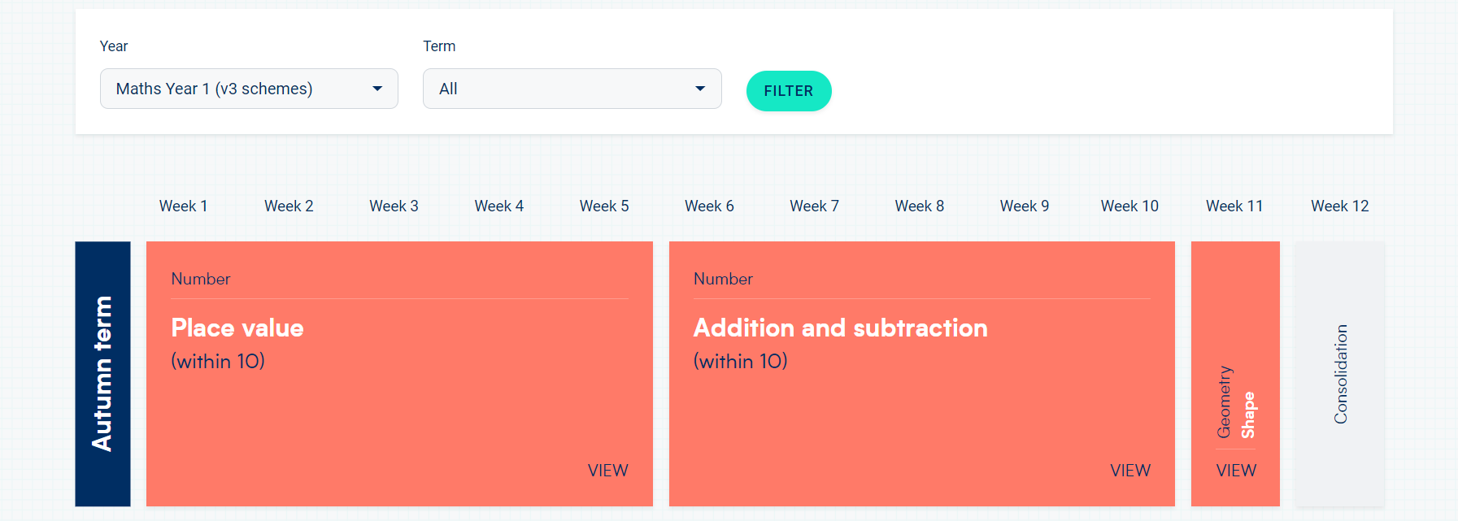
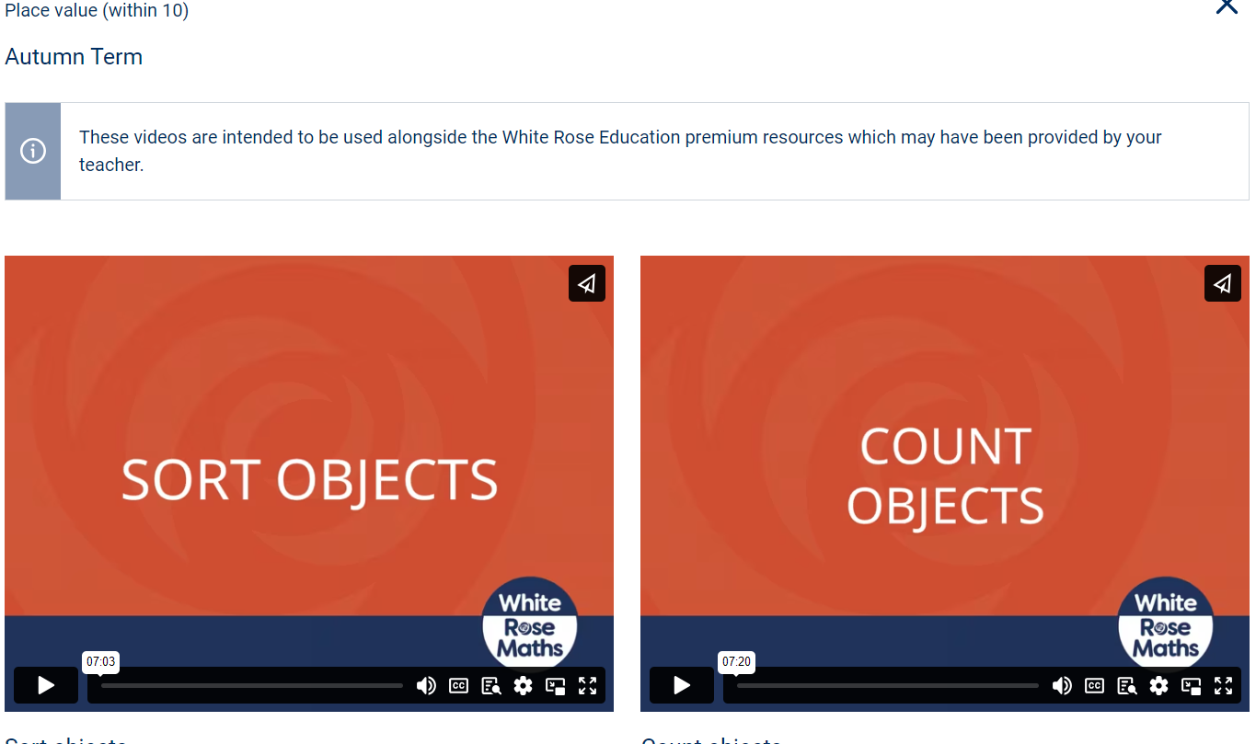
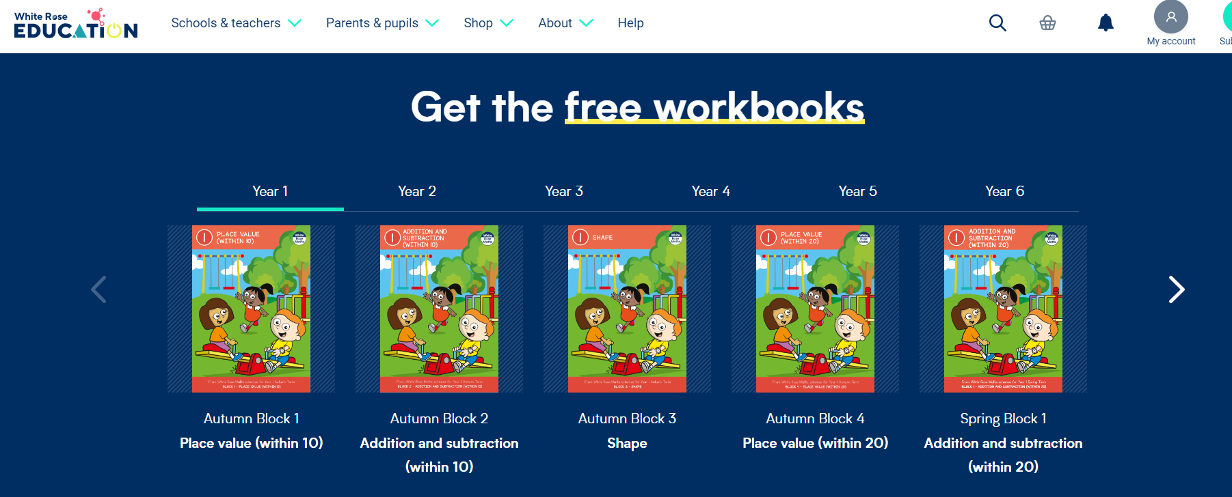
https://whiteroseeducation.com/parent-pupil-resources/maths/home-learning?year=year-1-new

Slide 30


Slide 31
Summary:
We teach the children the different mathematical strategies and allow them to become confident mathematicians.
We use whiteboards and a range of different concrete resources to support the children’s learning and development.
Once confident with a strategy we then ask them to apply it through problem solving activities and games.
Applying the skills learnt to different situations is the bit they find difficult

Slide 32
Thinking is at the heart of Mathematics and therefore should be at the heart of mathematical teaching and learning.
And most importantly maths is fun!

Slide 33
Any Questions?

